Slide 1
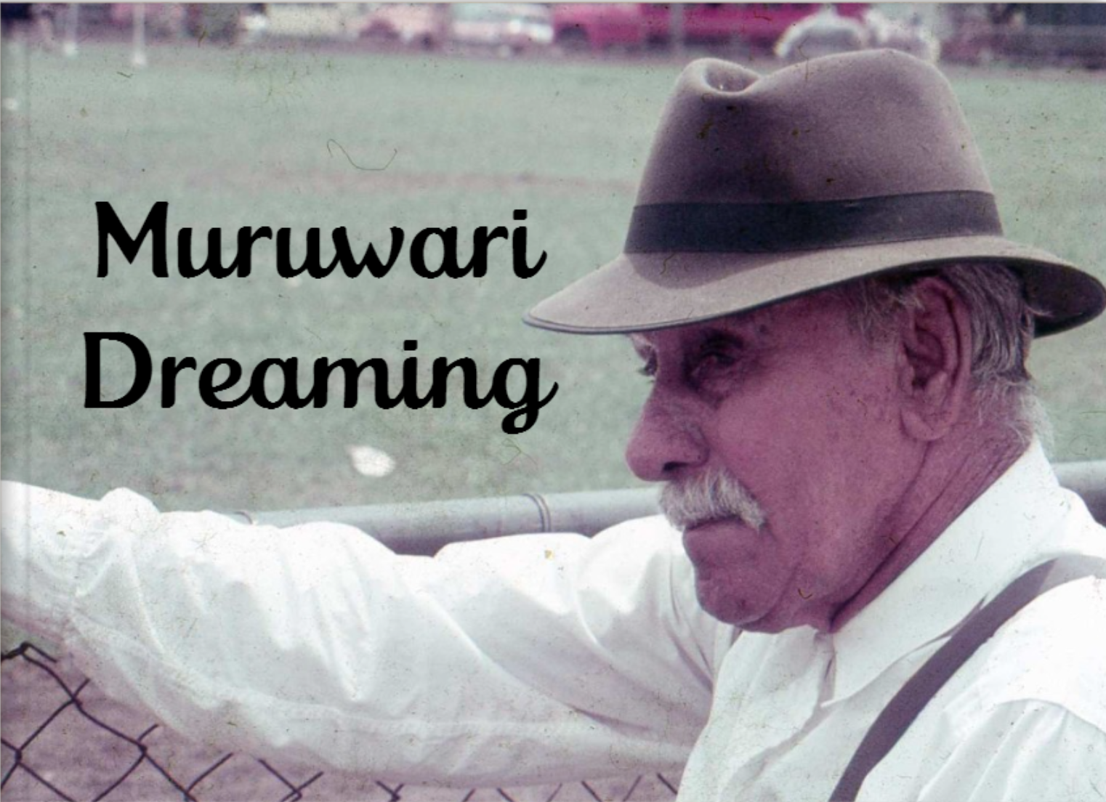

Location suffixes
Verb suffixes
Direction words
George Shearer

Slide 2
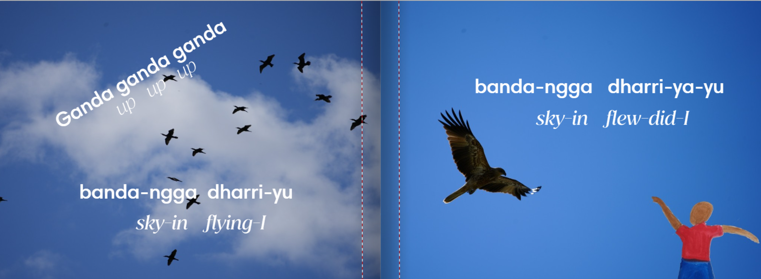
Eaglehawk – Muliyan Whistling eagle - Garra

Slide 3
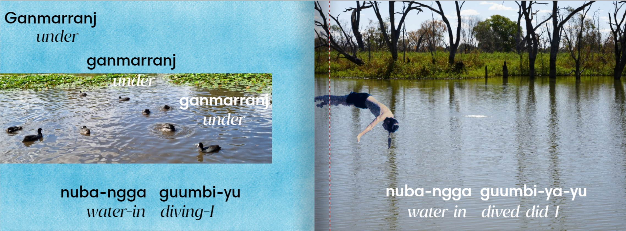
Duck (general word) – Mirringara
Black duck - Gundungal

Slide 4
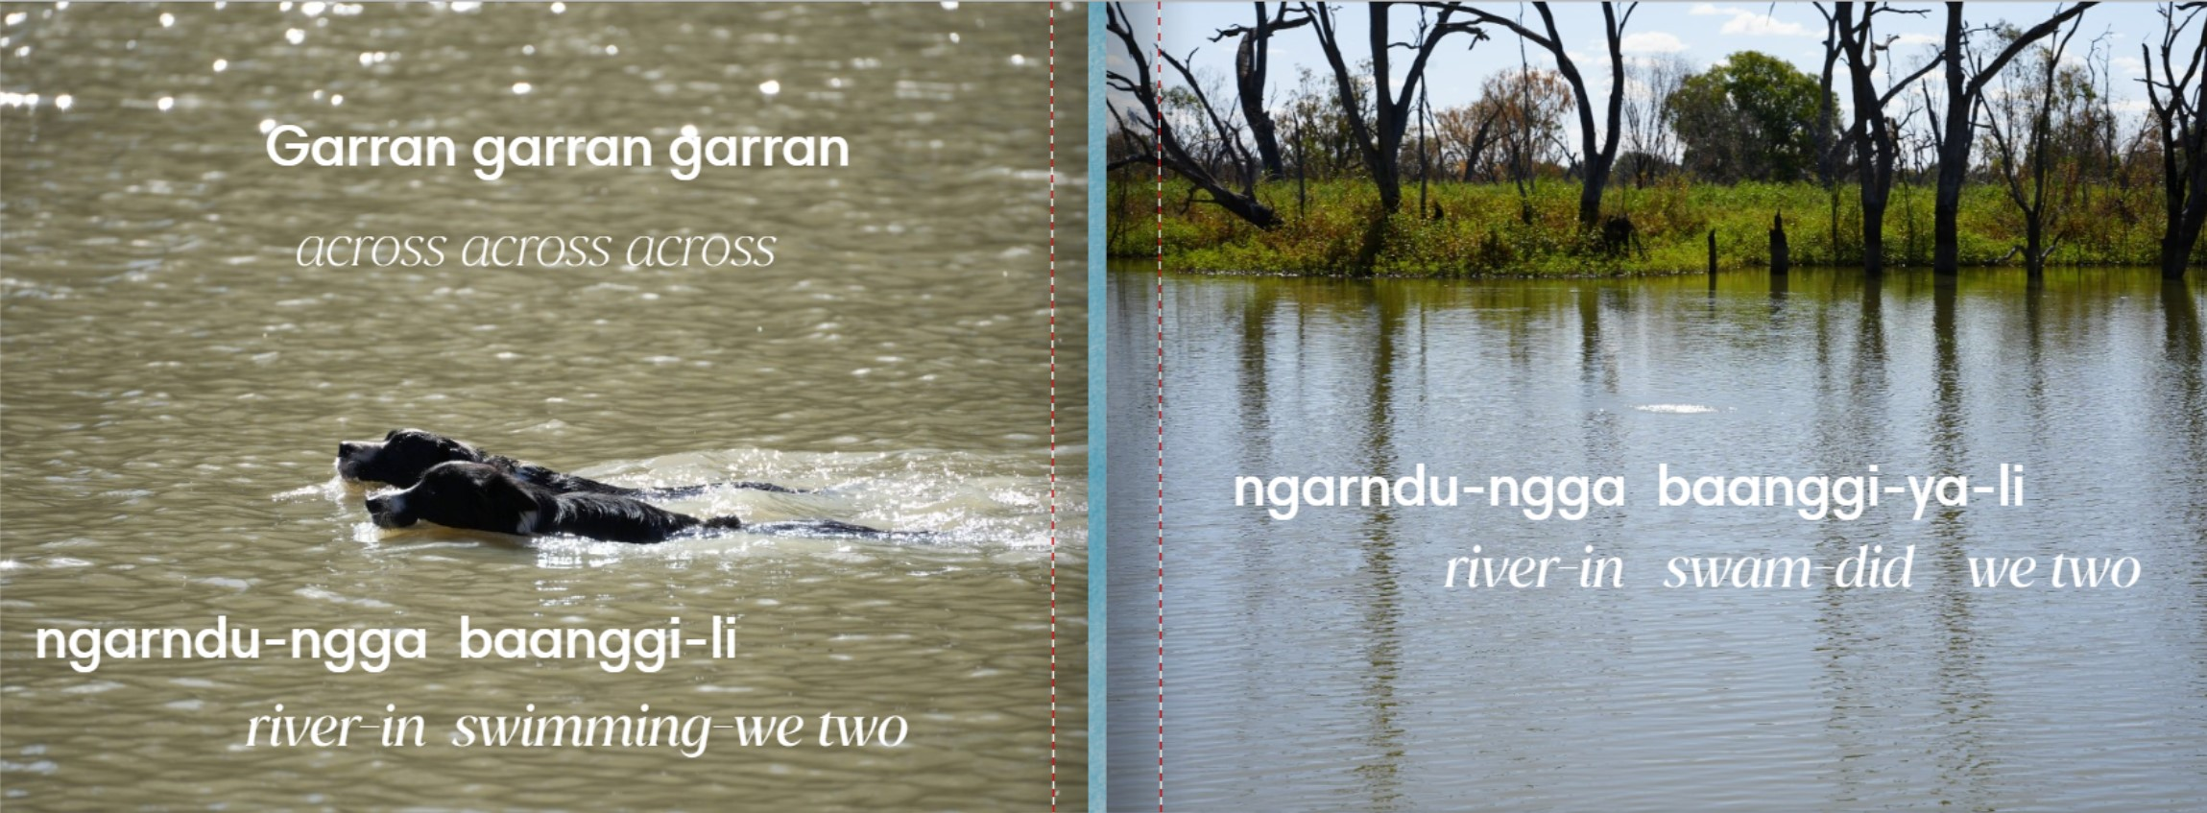
Domestic dog – Gungarl
Wild dog - Yugi

Slide 5
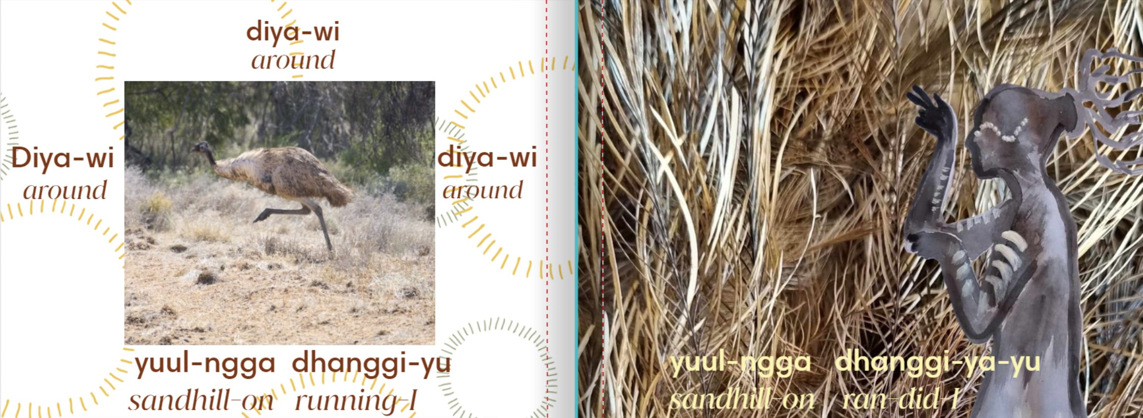
Emu– Ngurrunj

Slide 6
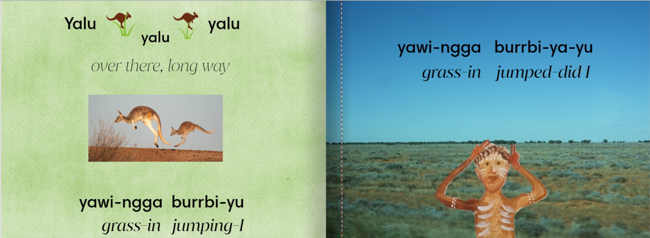
Kangaroo (general word) – Gula

Slide 7
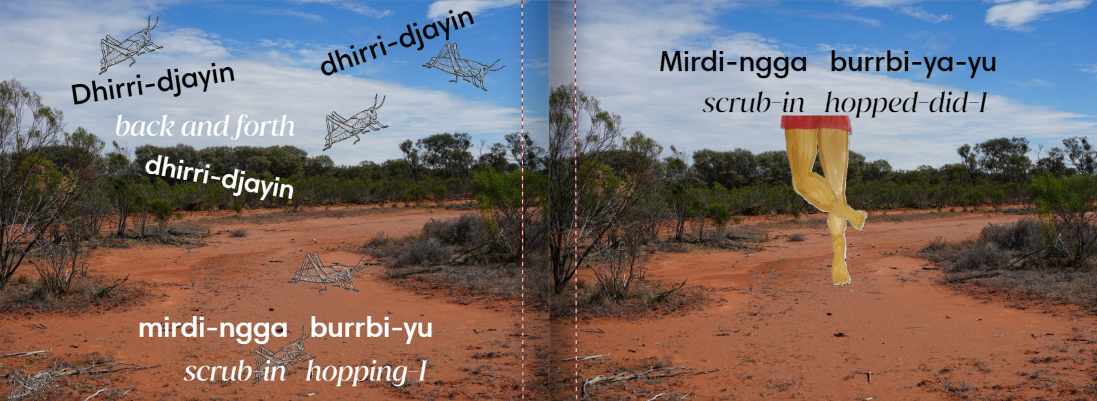
Grasshopper– banda-banda

Slide 8
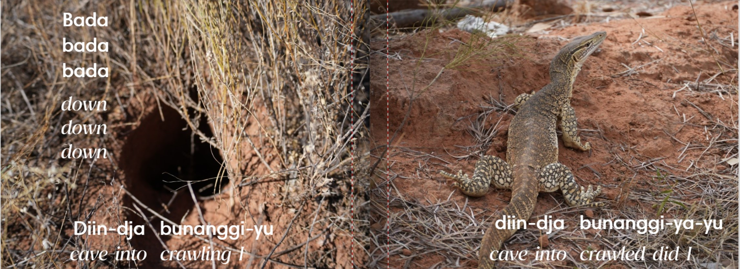
Sang goanna– Barna

Slide 9
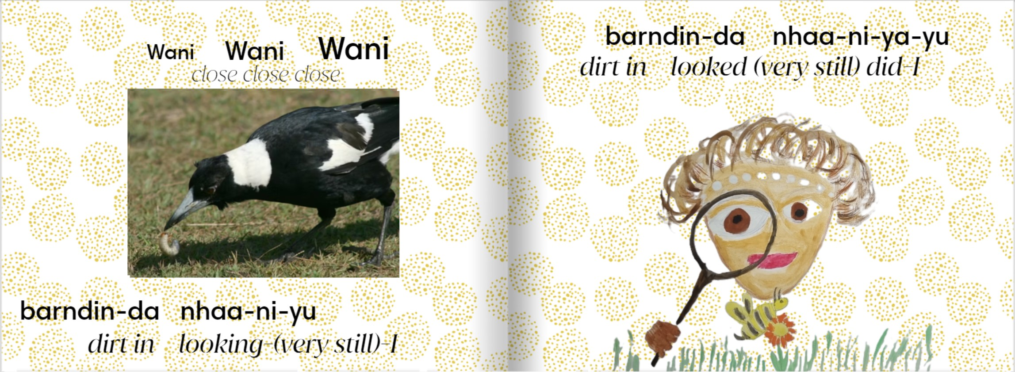
Magpie– Gurlbu

Slide 10
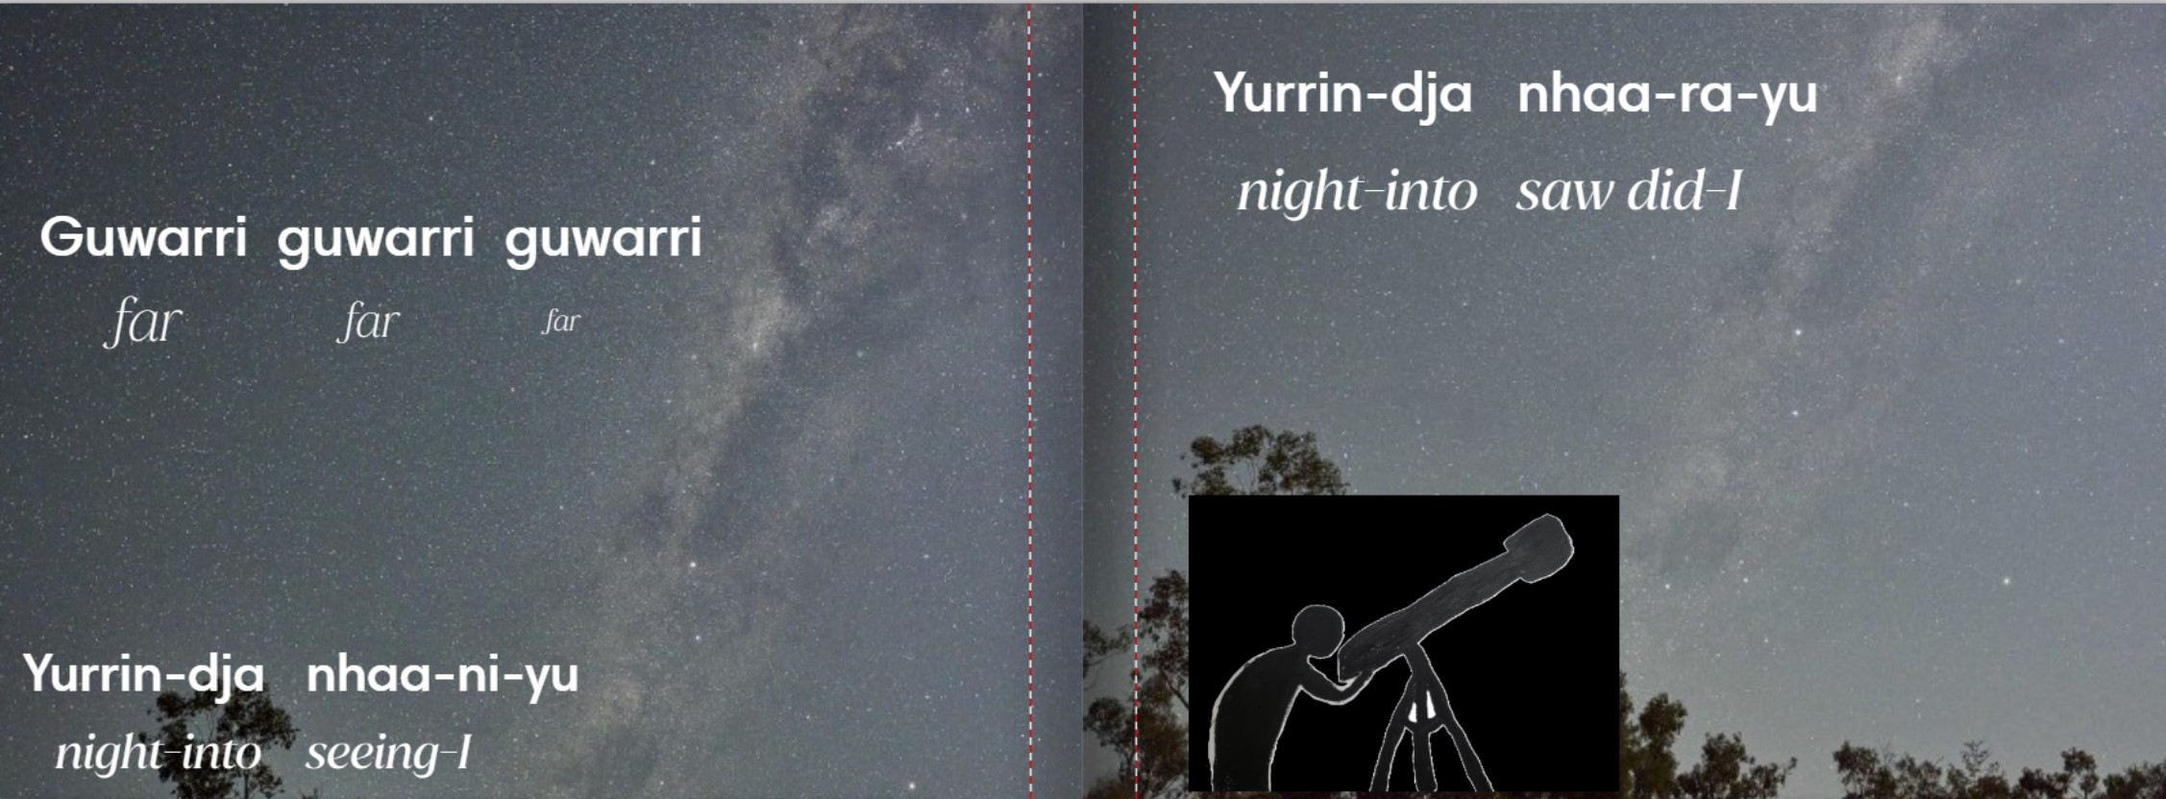
Stars – Mirrinj
The Milky Way (the galaxy) - baruwardu

Slide 11
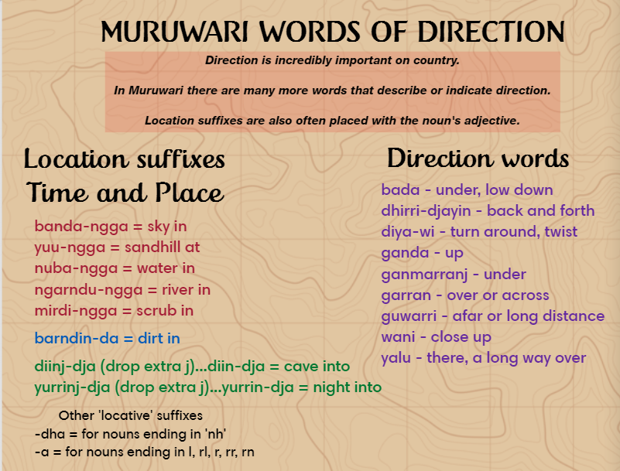

Slide 12
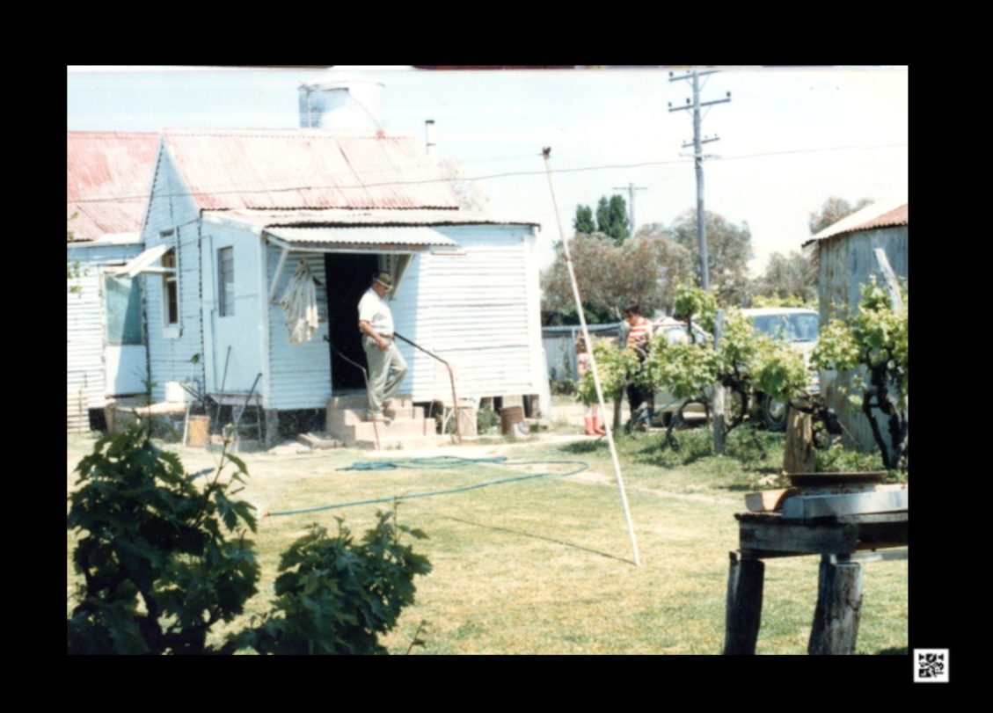
Gami-la-ndu Muruwari-dji yaan-gu-ndu.
When you return home you will be able to talk some Muruwari.

